Slide 1
Wat is uw associatie met
“Smart Factory?”

Slide 2
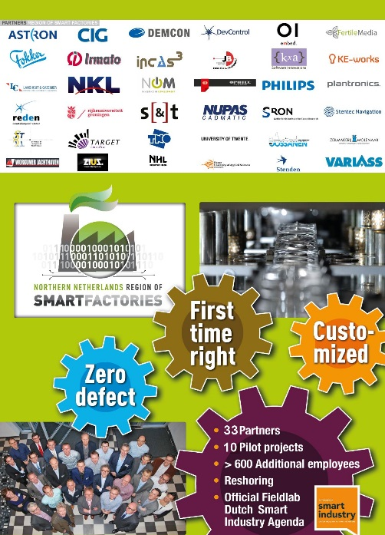
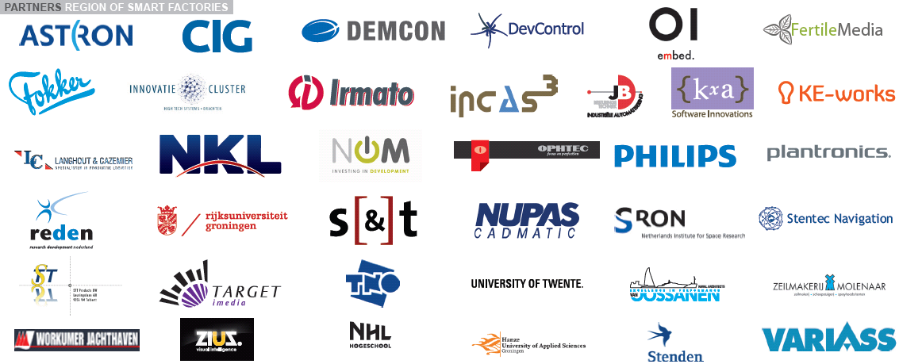

Slide 4
Intro RoSF
Businesscases
STT & Plantronics
Input Assessment!

Slide 5
www.rosf.nl

Slide 6
40 partners
Grootste Fieldlab Nationale Smart Industry Agenda
Business Development – ecostructuur en Branding
Budget 21 mio Euro (1e fase)
Synergie, spin-offs, van consortium naar community

Slide 7
Your journey to the Region of Smart Factories
Virtual Reality

Slide 8
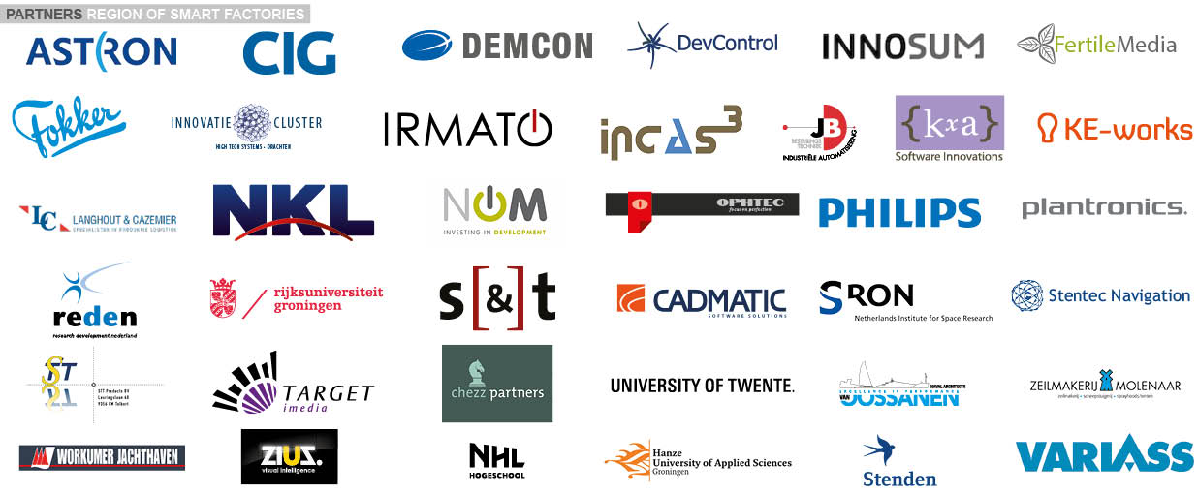

Slide 9
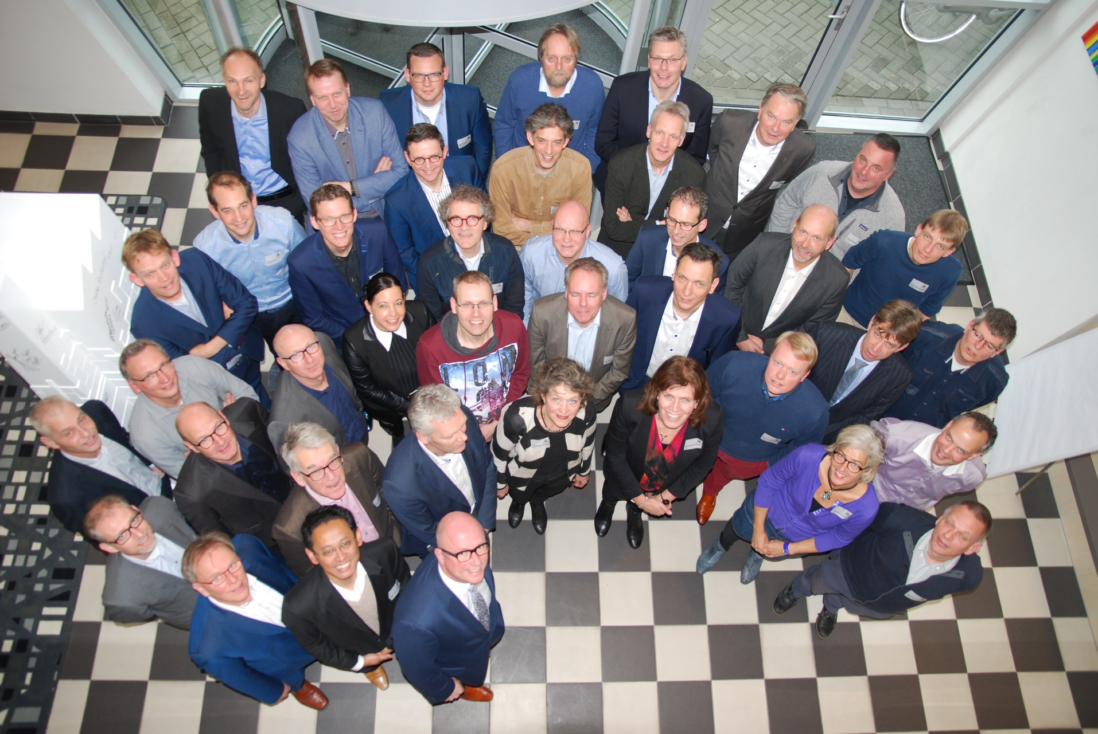

Slide 10
Slimme fabrieken voor slimme producten

Slide 11
We create Smart Factories for Smart Products
Intelligence
Connected
Customized
Products
Processes

Slide 12
Smart Factory concept
Customized products with the cost of mass manufactured product
Random production of different types
of products with varying specifications
Intelligent and connected manufacturing of intelligent and connected products, preferably both
Modelbased Engineering for First time right development of new products and production processes.
Zero defect (robust, predictable) manufacturing, even if it’s complex – without a high additional investment to rule out unforeseen occurrences.

Slide 13
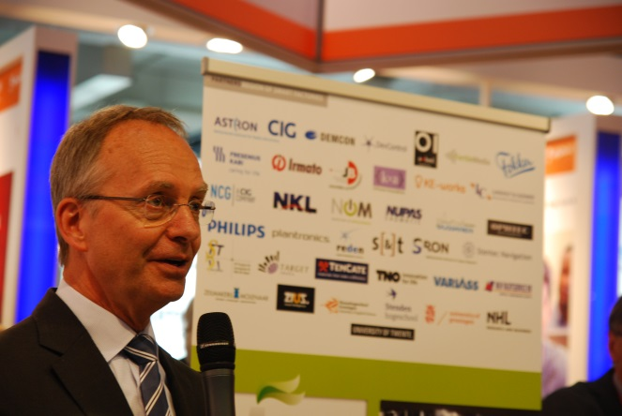
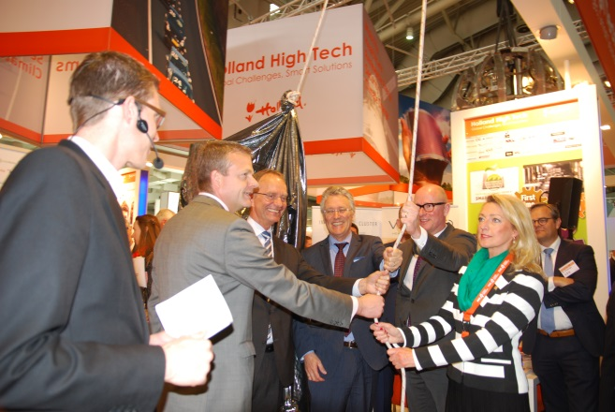
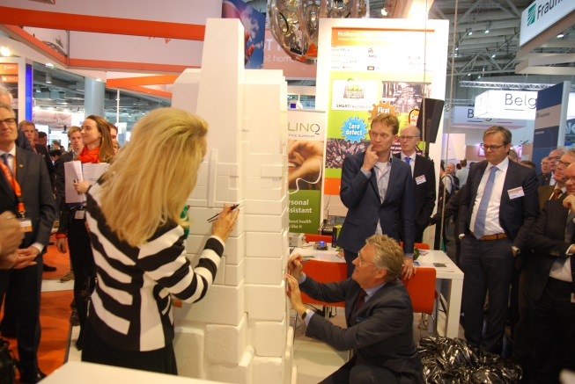
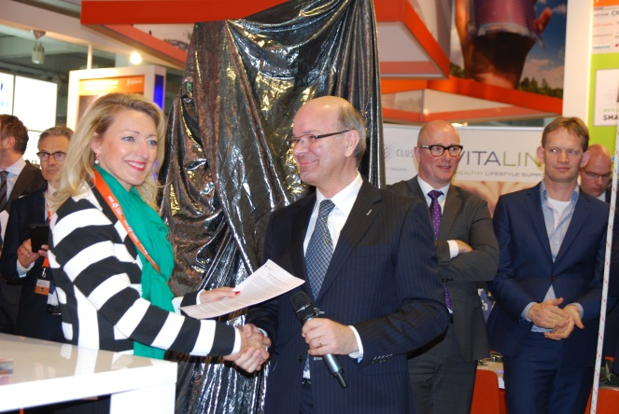
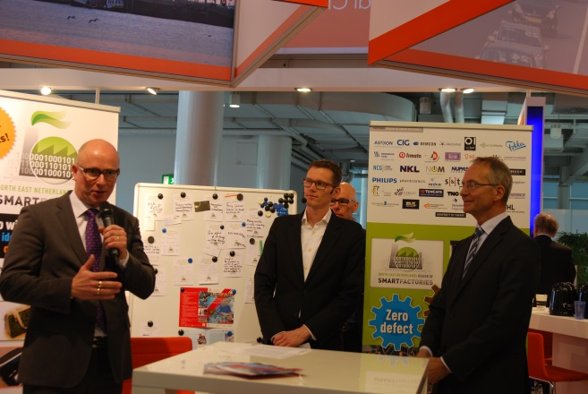
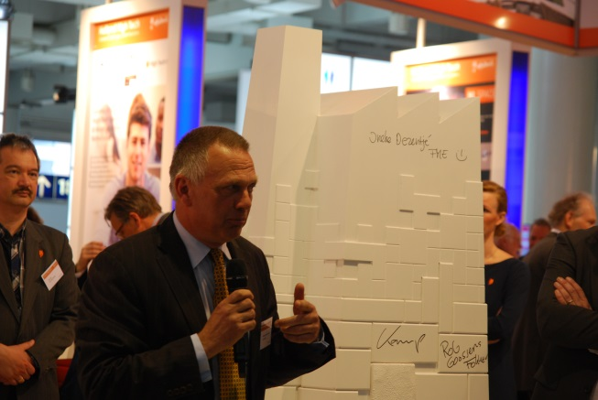
Hannover Messe

Slide 14
10 Smart Factories
Flexible Automation Shaver
Feed forward control Fuel Cel
Pilot factory wearables
Modelbased Engineering Shaver
Intergation CAD/CAM & PDM
3D Bending Shipbuilding
Customized Lenses in flow
Personalized Healttech IoT
Personalized Vision technology
Self Sailing boats

Slide 15
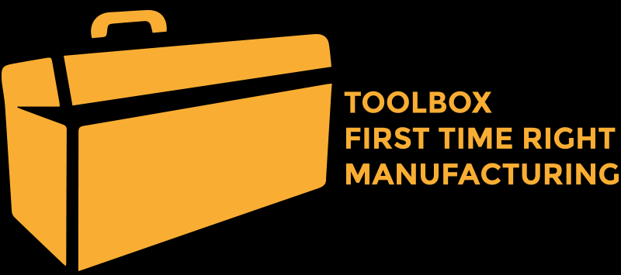
Make your factory a Smart Factory

Slide 16
RoSF Spin-off’s
Smart Feed Factory

Slide 17
Hoe kunt u meedoen?
Van consortium naar community
Meedoen aan RoSF-netwerk
Demo-bedrijf worden
Kick-off: 30 januari 2017

Slide 18
Modelbased Engineering Shaver
Personalized Vision technology
Feed forward control Fuel Cel
Integration CAD/CAM & PDM
Self Sailing boats
Flexible Automation Shaver
Pilot factory wearables
Customized Lenses in flow
Personalized Health tech IoT
3D Bending Shipbuilding
Data analitics
Robotics and Mechatronics
Equipment and Sensors
Advanced Manufacturing
Lifecycle Management
Cyber-physical Systems
Human Technology
Production Management

Slide 19
Industry 4.0 Challenges | Demonstrator
Self-learning manufacturing | Philips Shavers
Fist time Right | E-Lighter Fokker
Smart Pilot Factory | Wearables @ Plantronics
Modelbased engineering | Philips shaving head
Integration CAD/CAM & PDM | Shipbuilding CADMATIC
Smart Factory for buidling kits | Steel supply Centraalstaal
Customization in flow manufacturing | Lenses NKL and Ophtec
Modelbased design & feed foward control | Smart Sailing
Connected devices IoT | Pers. Care Products Philips
Personalized vision | ZiuZ dispensing machine

Slide 20
RoSF Assessment
Passief
Reactief
Proactief
Lerend
Smart
Product-
ontwikkeling
Productie
Faciliteiten
Invullen
Productie-besturing
Rol data
Leervermogen
Etc
Nivaus beoordelen, vergelijken, next steps indentificeren
Afspraak: standaard meetlat, nationaal uitrollen

Slide 21
Aan welke criteria moet de Smart Factory voldoen?

